Slide 1
Stage 3: Growing our own ingredients

Slide 2
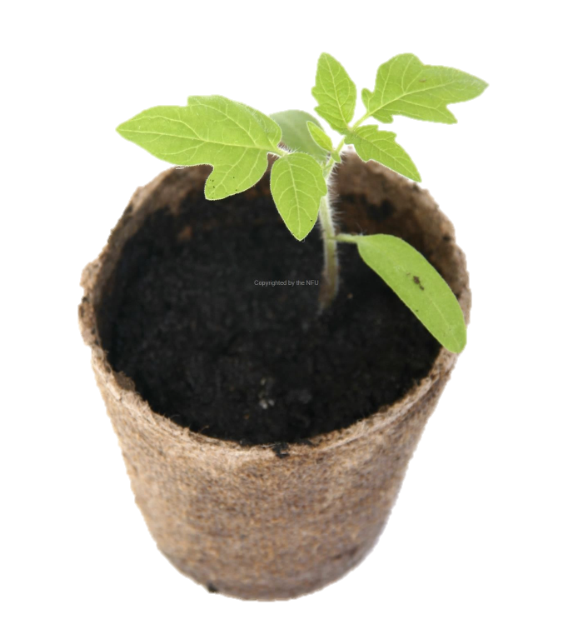
Learning Objectives:
To grow vegetables from seeds
To plot a line graph
Talk to your partner: what do plants need to grow?

Slide 3
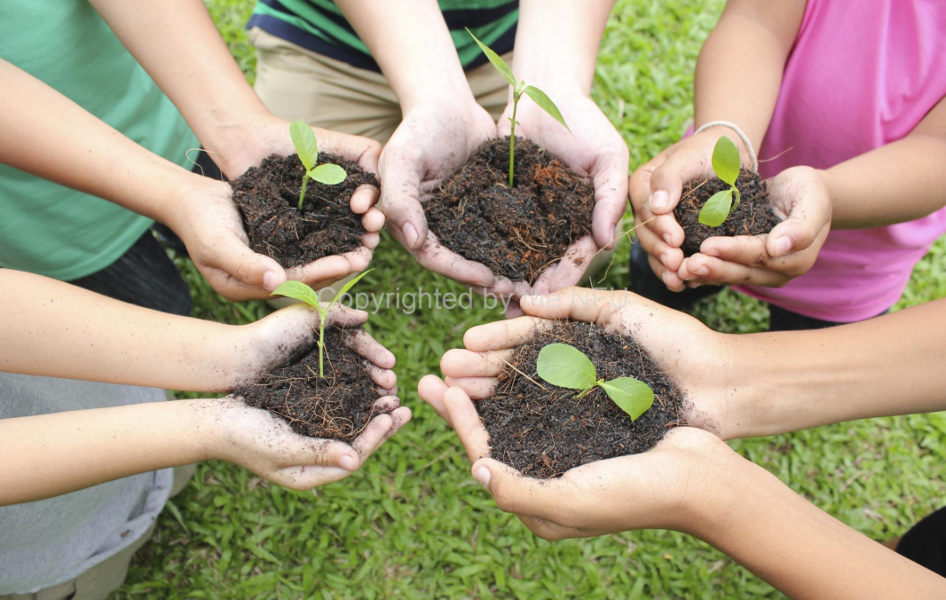
In order to grow healthy crops that we can use to make our food product, we need to make sure that they have the following things:
Air
Light
Warmth
Water
Nutrients

Slide 4
Watch the video to learn about the conditions carrots need to grow.
https://www.youtube.com/watch?v=mRdavbBf2Gs

Slide 5
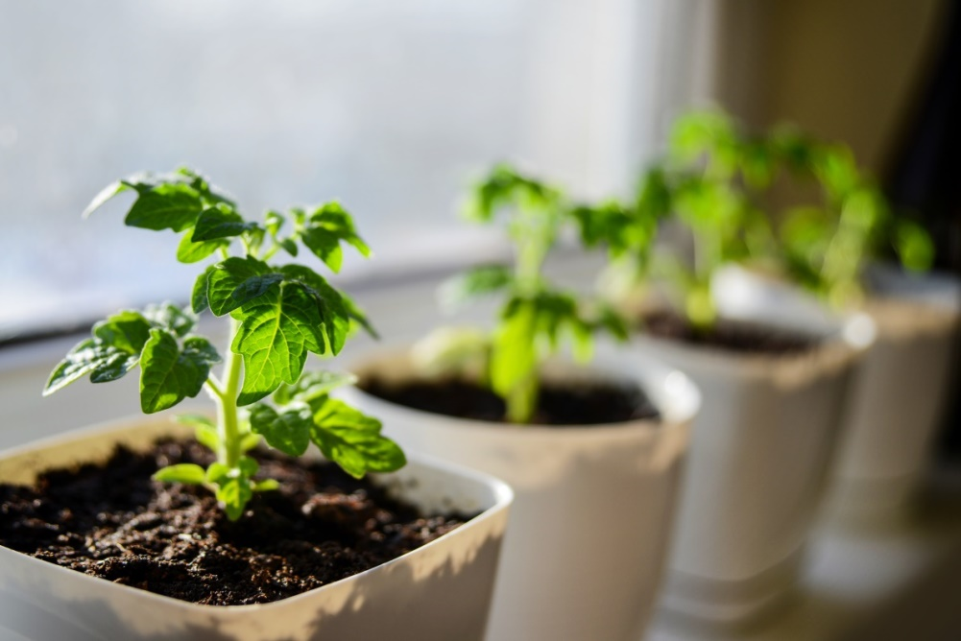
Where would be the best place in the classroom for us to keep our plants so that they have all the things they need to grow?

Slide 6
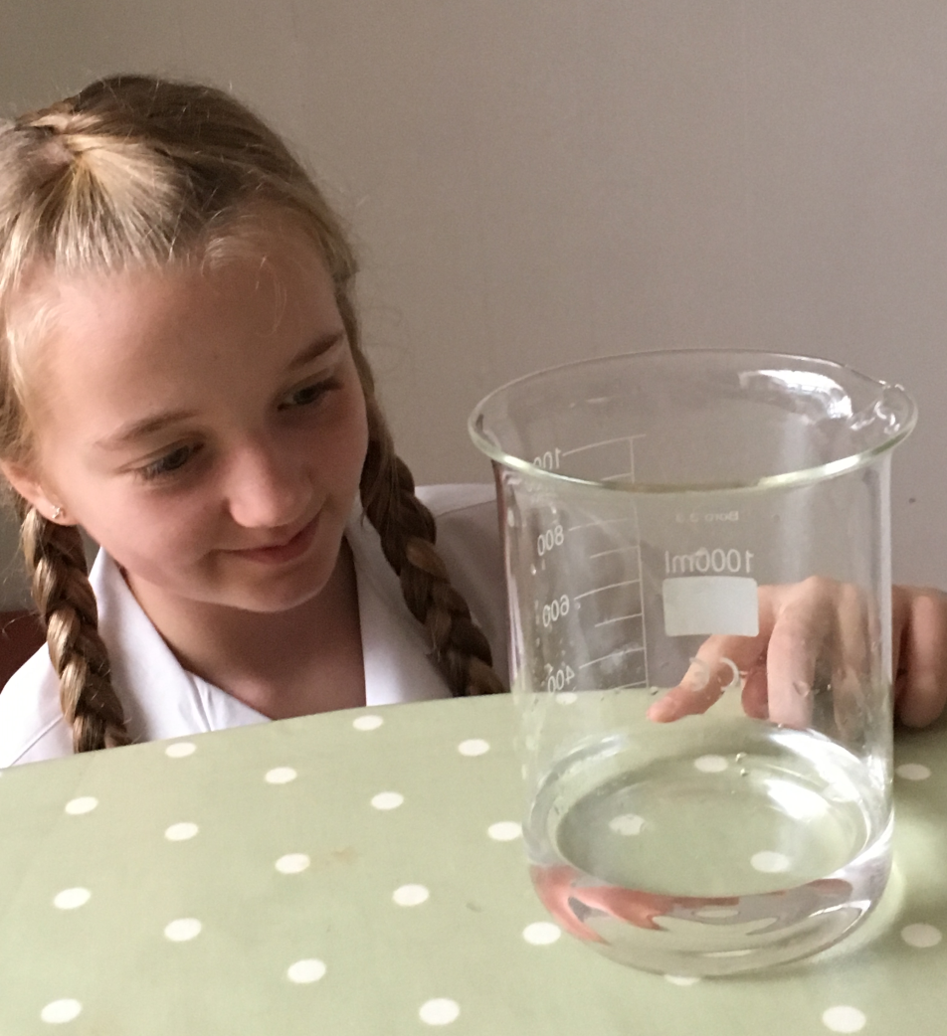
How do we measure water accurately?

Slide 7
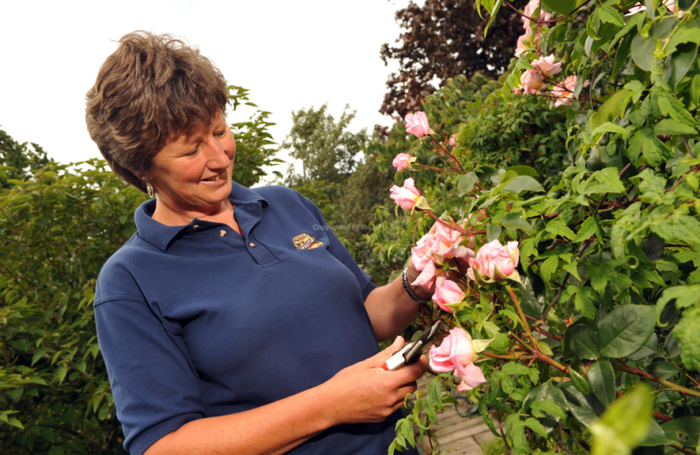
We are going to monitor the height of our plants to check our crops are developing healthily.
Why do you think it is important for farmers to monitor the health and growth of their crops?

Slide 8
We are going to record our results in a table so we can use the data to plot a line graph.
What can you remember about line graphs?

Slide 9
Line graphs
Line graphs are used to show how a variable changes over time.
Straight lines join a series of points together.
The horizontal axis is called the x axis; this shows regular intervals of time.
The vertical axis is called the y axis; this shows the variable we are measuring over time (in this case, the height of the plant).

Slide 10
Drawing a line graph
Draw your graph on squared or graph paper
When deciding on a scale for your y axis, look at the data you have collected to see how large your range is.
Your scale should go up in regular intervals: twos, fives or tens usually work well.
Remember to start your y axis at zero.
Your x axis will show how many days old your plant was when each measurement was taken.
Remember to leave an equal number of squares between each number on your x axis.
Mark the height of your plant at each time point on the graph with a cross and then join all your crosses together with a ruler.

Slide 11
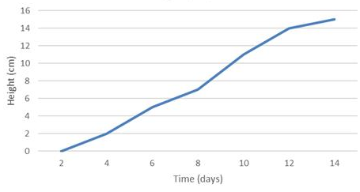
Drawing a line graph
The scale increases in regular intervals
Plant height
x
x
The scale starts at zero
x
Y axis
x
x
x
x
Time is always shown on the x axis
Points are joined with straight, ruled lines.
X axis

Slide 12
Reading a line graph
Swap graphs with a friend and read their graph to answer the following questions.
How tall was their plant after 10 days?
How tall was their plant after 14 days?
How much did their plant grow between day 8 and day 15?
What was the difference between the height on day 5 and on day 17?
On which days did the plant grow the fastest? How do you know?
What was the range of heights they recorded?
What might the line graph look like if you put the plant in the dark from day 7 to 12?
What might the line graph look like if you added fertiliser to the compost on day 9?

Slide 13
Conversion revision
Swap graphs with a friend and read their graph to answer the following questions.
How many millimetres tall was their plant on day 11?
How many millimetres tall was their plant on day 19?
How many metres tall was their plant on day 14?
How many metres tall was their plant on day 18?
Did you choose to measure in cm or mm? Why? Why did we not measure in metres?

